Slide 1

Walmart Store Sales Prediction
Pooja Bhadra

Slide 2
Objective:
Build Regression Models to predict Walmart store sales.
Evaluate and compare the performance of models.

Slide 3
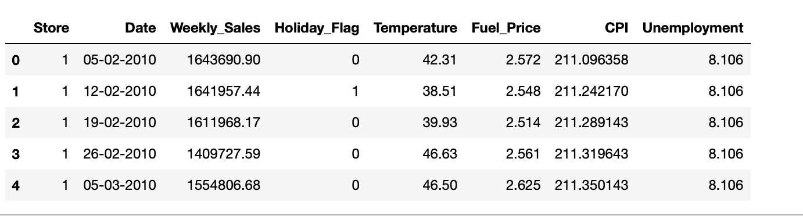
About the Data
Data Source: Kaggle.com
Data covers Walmart sales from 2010-02-05 to 2012-11-01
Variables:
Store - Store number
Date - Week of sales
Weekly Sales - Sales for the given store
Holiday Flag - Whether the week is a special holiday week 1 – Holiday week 0 – Non-holiday week
Temperature - Temperature on the day of sale
Fuel Price - Cost of fuel in the region
CPI – Prevailing consumer price index
Unemployment - Prevailing unemployment rate

Slide 4
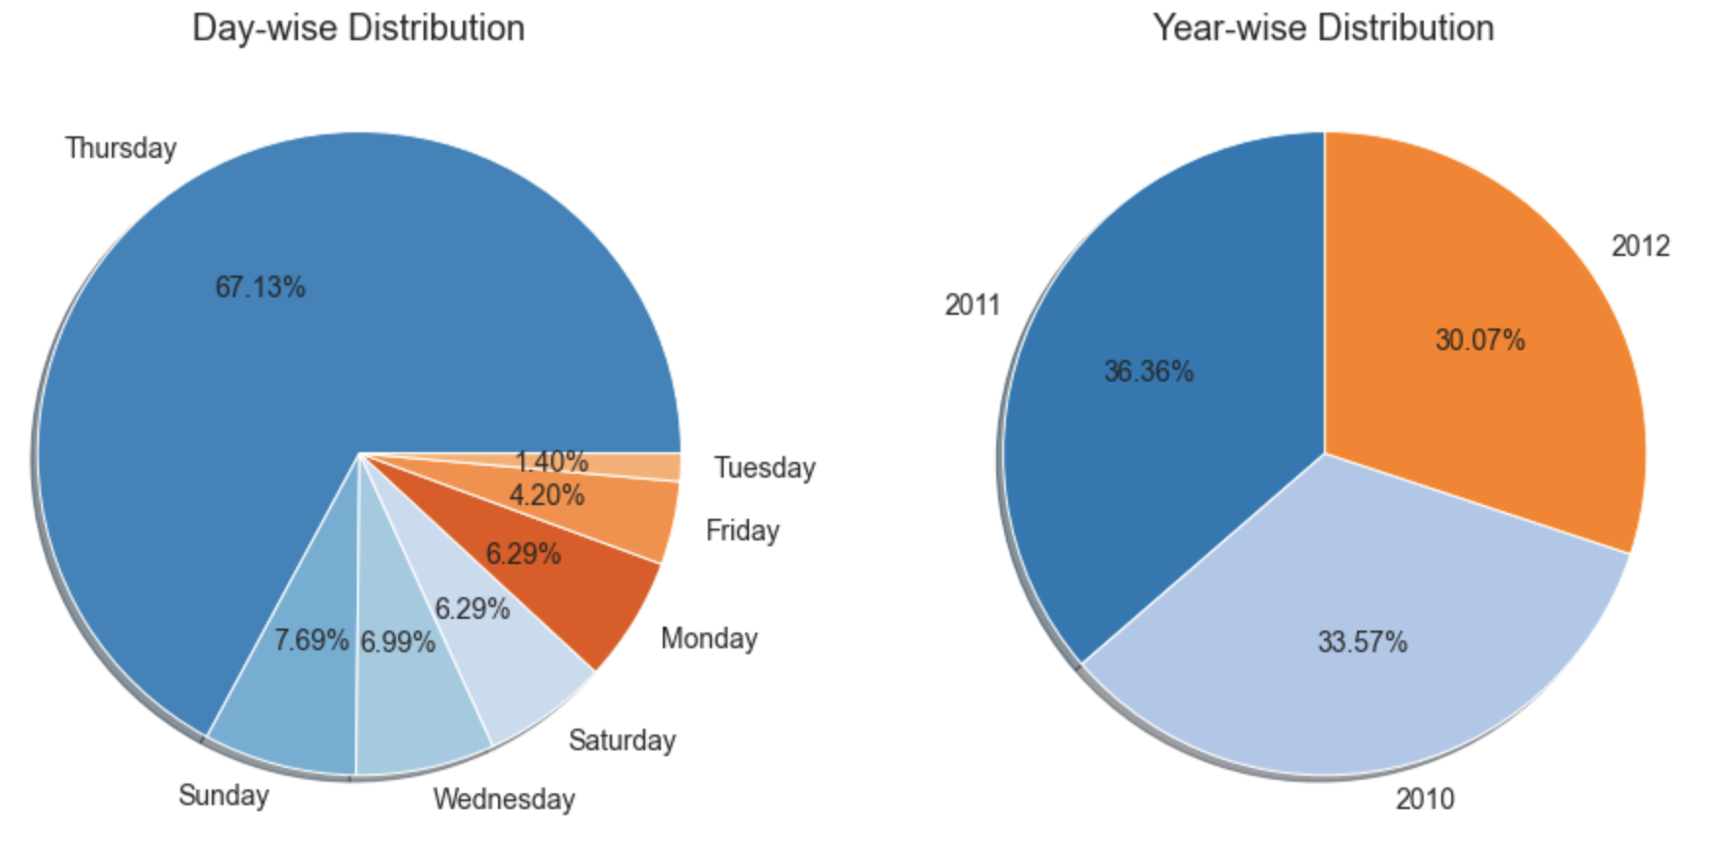
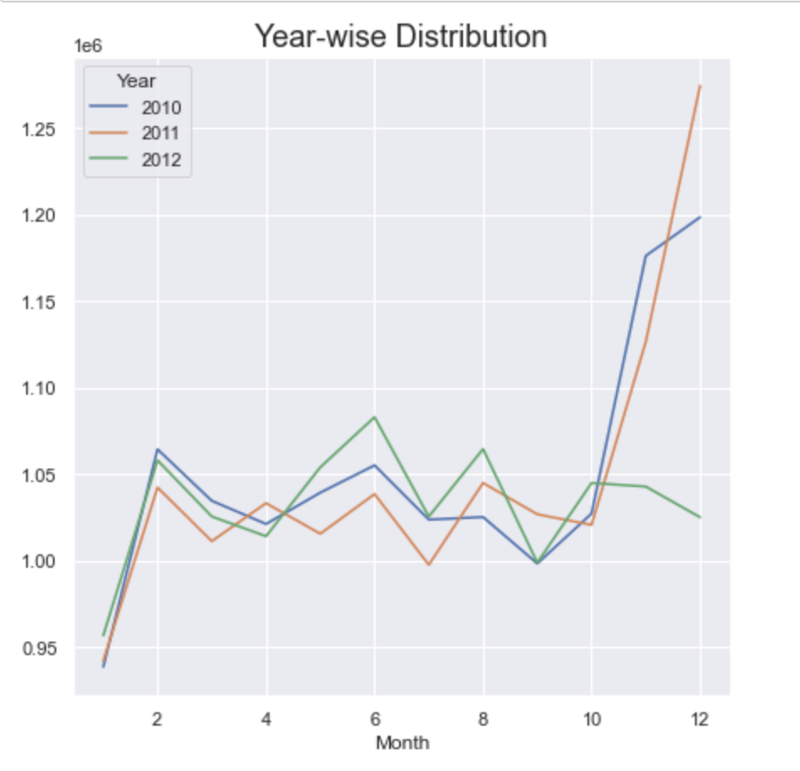
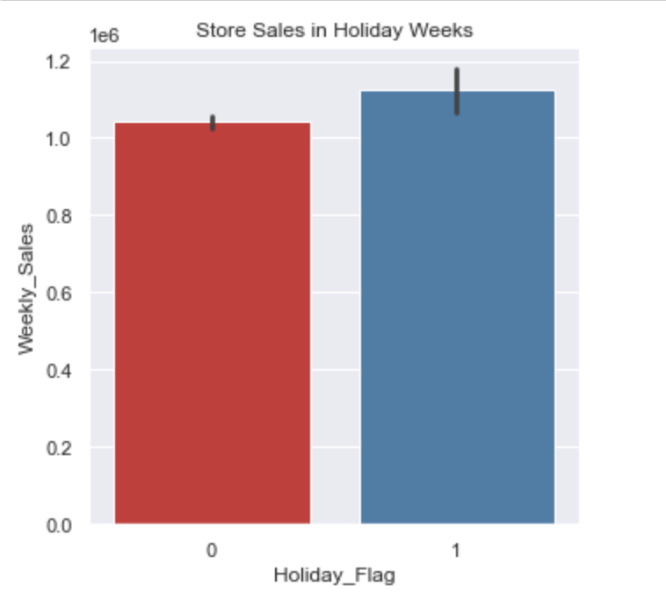
Exploratory Data Analysis
Charts speak louder than words

Slide 5
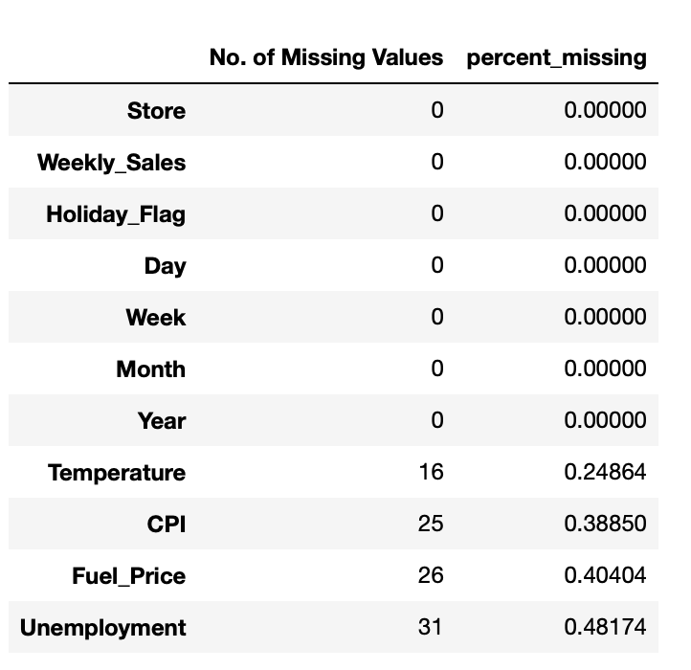
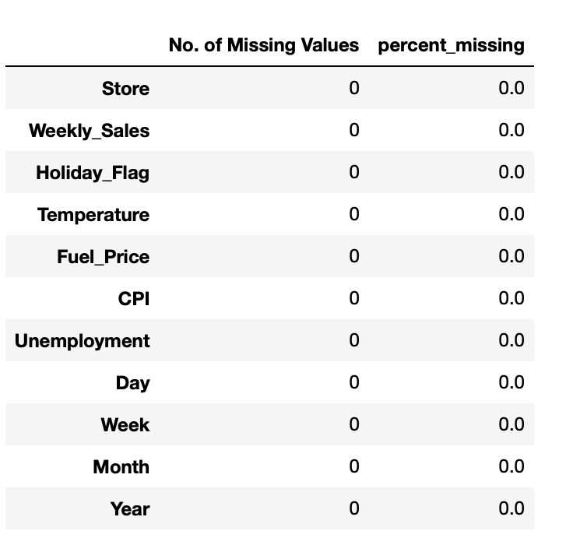
Missing Values
Imputed Missing Values using K-nearest neighbor model

Slide 6
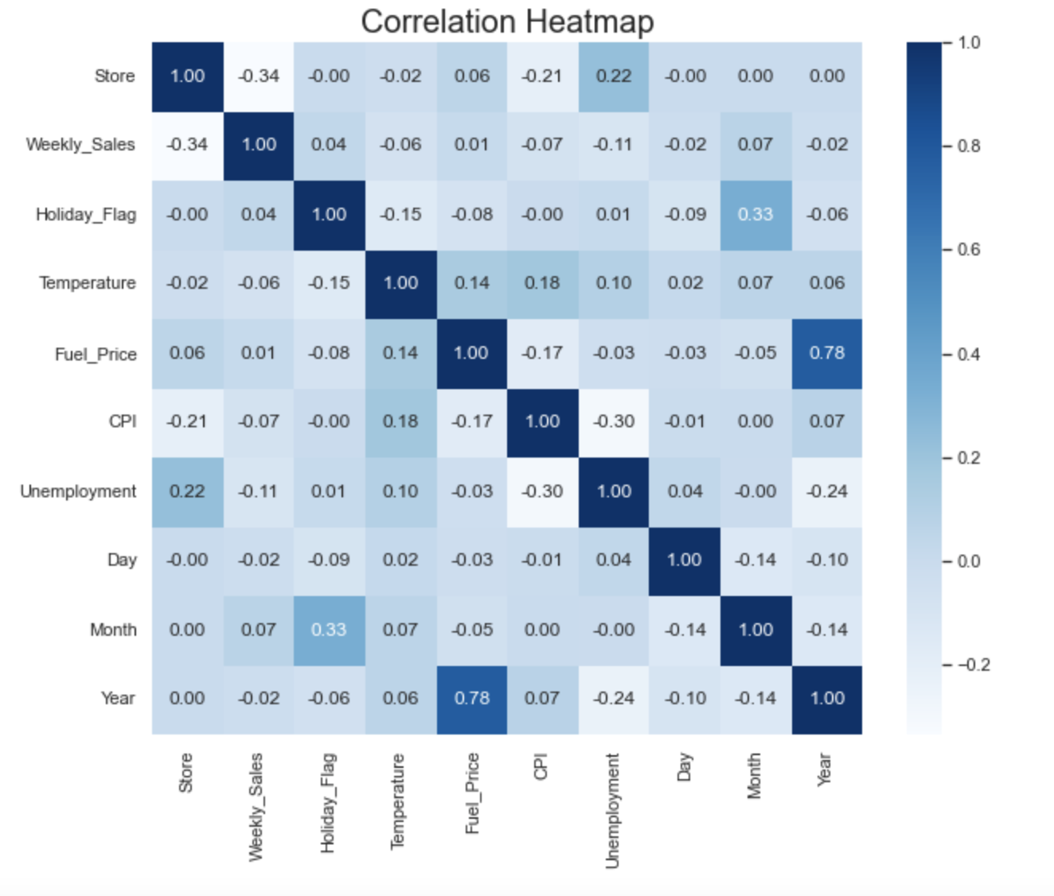
Feature Engineering

Slide 7
Defining Dependent and Independent Variables
Independent Variable:
Weekly Sales
Dependent Variables:
Store
Holiday Flag
Temperature
Fuel Price
CPI
Unemployment
Day
Month
Year

Slide 8
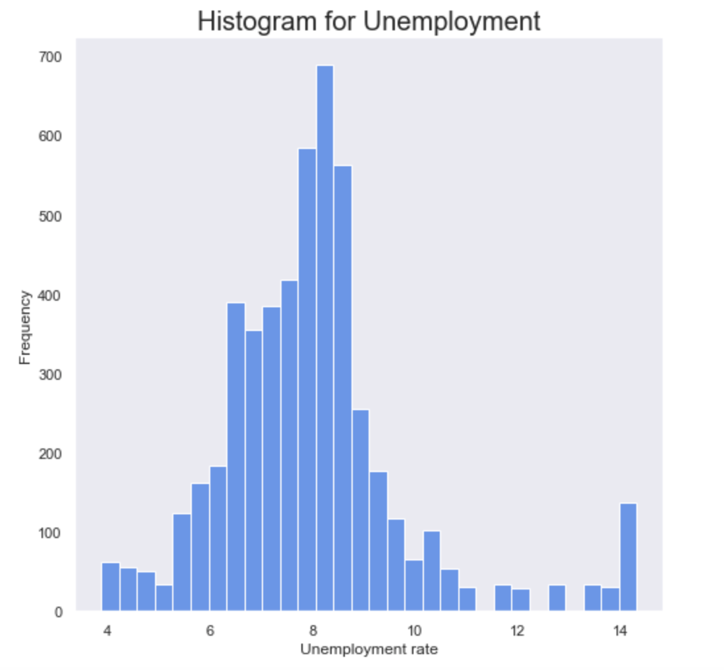
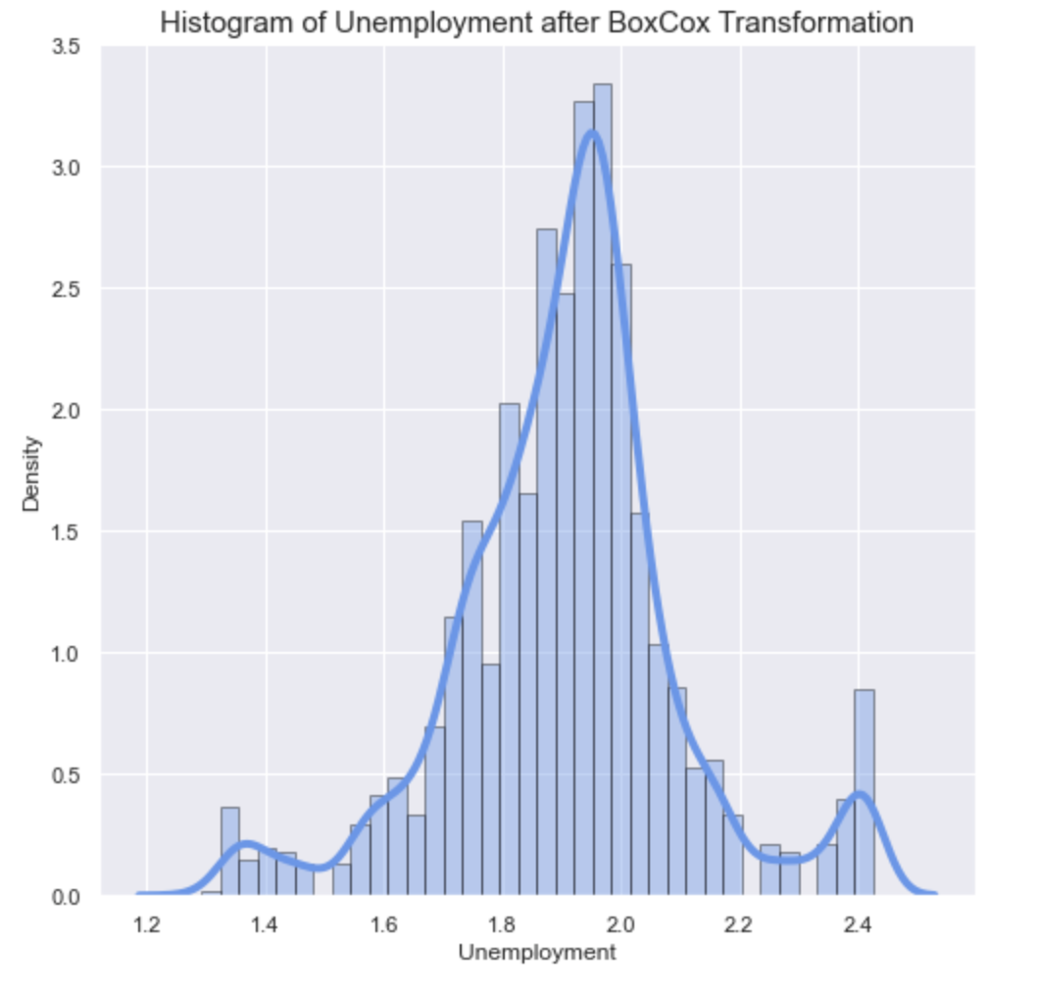
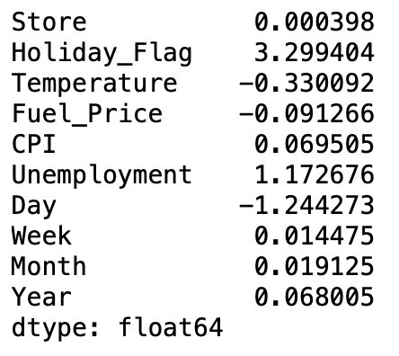
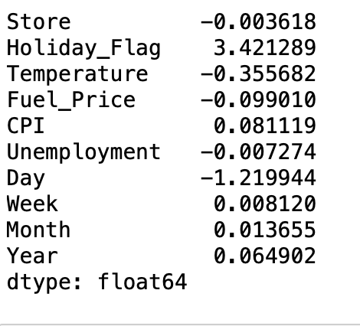
Skewness & Scaling

Slide 9
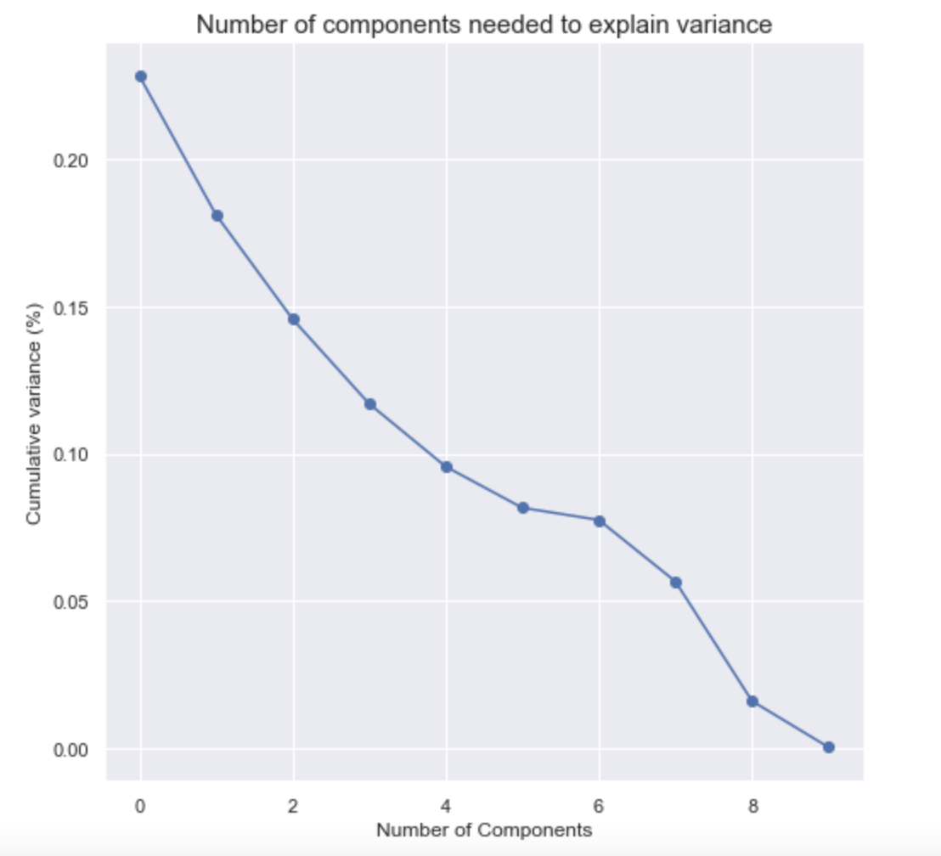
Principal Component Analysis

Slide 10
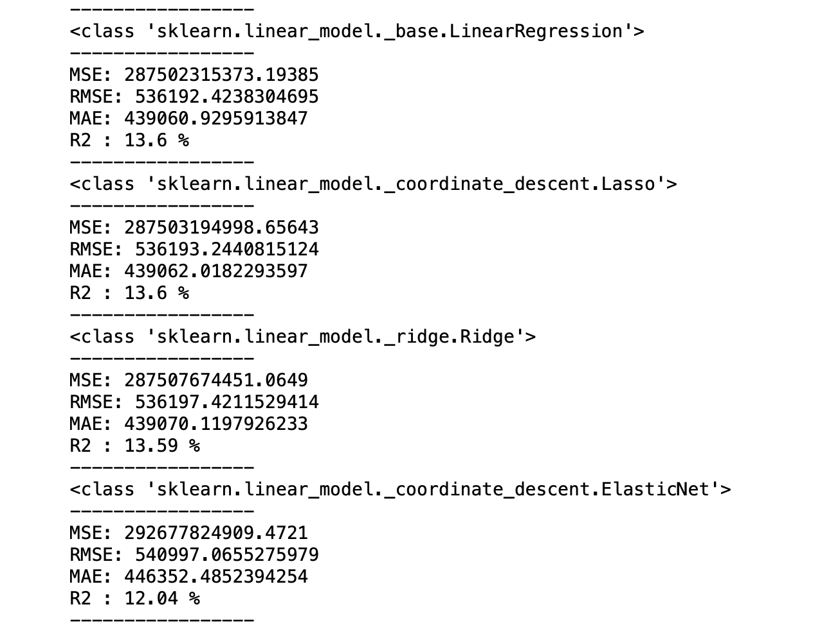
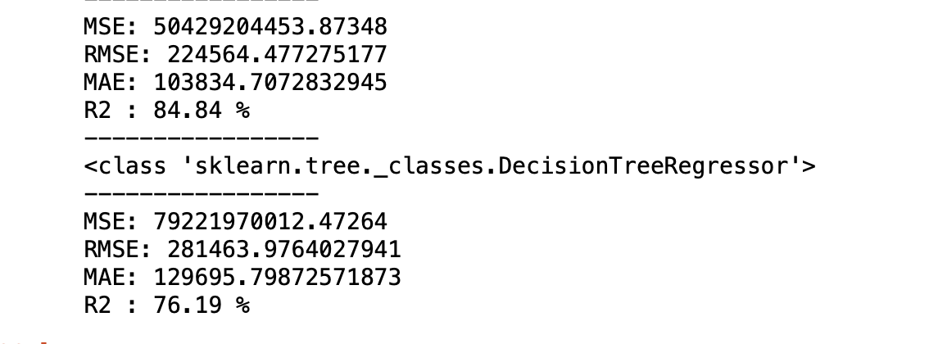
Models
ElasticNet Regression
Linear Regression
Lasso Regression
Decision Tree Regressor
Ridge Regression
Random Forest Regressor

Slide 11

Conclusion
Random Forest Regressor outperformed all the regressors with highest R_squared (85%) and lowest RMSE.
Using this Machine Learning algorithm, Walmart stores can understand the factors that drive sales and predict the future sales.
Accordingly, the business can take decisions regarding inventory, staffing, and marketing.

